Slide 1
Qui trình Phát triển PM Software Process
Tập các hoạt động, các bước cần thiết để thực hiện một mục đích là phát triển và mở rộng PM
Đặc tả (Specification)
Thiết kế & Hiện thực (Design & Implementation)
Kiểm thử chấp nhận (Validation)
Mở rộng & Phát triển (Evolution)

Slide 2
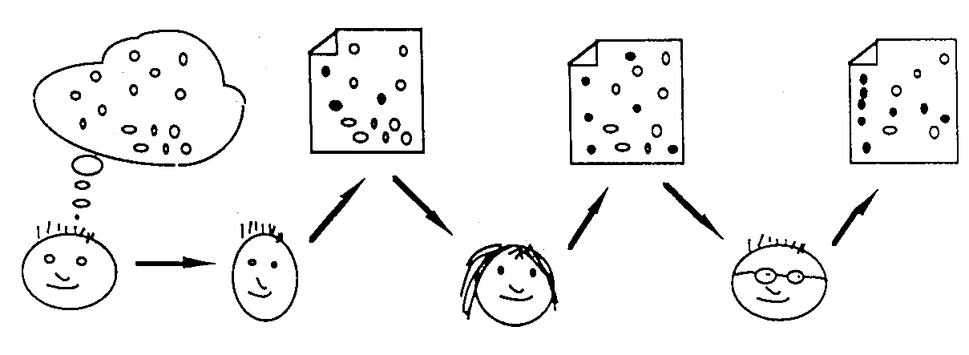
Qui trình phát triển PM tính đến 1970: vẫn được xem là 1 black box
Only until 1970?
informal requirements
Software development process
Program code
customer
What happens inside?

Slide 3
Mô hình Qui trình PM (Software process model)
Một thể hiện đơn giản của qui trình phần mềm.
Các hoạt động
Biến đổi dữ liệu
Vai trò của những người tham gia vào CNPM

Slide 4
Mô hình Qui trình PM (Software process model)
Ví dụ: thể hiện của qui trình.
Workflow - sequence of activities;
Data-flow - information flow;
Role/action - who does what.
Các Mô hình Qui trình
Thác nước (Waterfall)
Phát triển lặp (Iterative development)
CNPM thành phần (Component-based SE)

Slide 5
CASE Tools là gì? (Computer-Aided Software Engineering)
Những phầmn mềm, công cụ cung cấp hỗ trợ tự động cho những họat động trong qui trình làm phần mềm.
Upper-CASE: những công cụ hỗ trợ giai đoạn requirement & design;
Lower-CASE: những công cụ hỗ trợ giai đoạn programming, debugging & testing.

Slide 7
Software Development Process
Reference: http://www.comp.lancs.ac.uk/computing/resources/IanS/
Notes:
Giáo án:
Buổi 1 (3 tiết):
Cho cả lớp review lại kiến thức bài hôm trước. Mỗi người nói một câu gì đó học được từ hôm trước.
Giải thích khái niệm qui trình
Trình bày qui trình Water Fall, các bước, mục tiêu, đầu vào và đầu ra ở mỗi bước.
Thảo luận sinh viên: lâu nay đã làm gì ở mỗi bước? Khó khăn gì trong quá trình triển khai làm chương trình, sản phẩm PM
Bài tâp tại lớp & về nhà (nhóm đã đăng ký): tìm hiểu về một công ty PM và qui trình họ đang làm? Mô tả tóm tắt thông tin. (Mạng, Quan hệ). Nộp trên Moodle trước buổi học ngày hôm sau.
Review lại bài học ngày hôm nay. Mỗi người nói một câu gì đó học được từ hôm nay.
Buổi 2 (3 tiết):
Cho cả lớp review lại kiến thức bài hôm trước. Mỗi người nói một câu gì đó học được từ hôm trước.
Trình bày tổng quan về tiếp cận phát triển tiến hóa (Evolutionary Development): ưu điểm, hạn chế
Một số loại mô hình như: xoắn ốc, V-Model, Prototypeping
Bài tập tính điểm quá trình số 1 (0,5đ): yêu cầu sinh viên tìm kiếm thông tin và trả lời các câu hỏi (Thác nước/Xoắn ốc/V-Model... Là gì? Đề xuất năm nào? Ai là tác giả? Ưu điểm hạn chế của mỗi mô hình, nguồn tài liệu/thông tin tham khảo .... Trả lời trên lớp hoặc submit lên website môn học)

Slide 8
Objective
Nắm khái niệm cơ bản qui trình. Hiểu được các bước trong qui trình phần mềm
Nắm được một số qui trình cổ điển.
Hiểu và có khả năng áp dụng mô hình thác nước vào đồ án.

Slide 9
Topics covered
Some popular software process models
Process iteration
Process activities

Slide 10
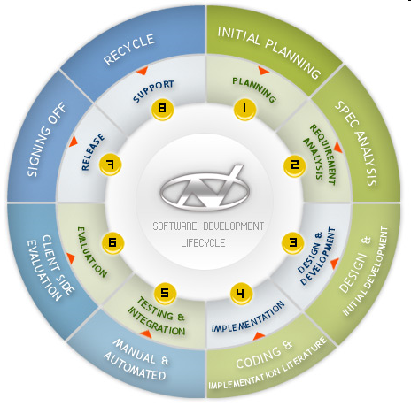
Software Development Process

Slide 11
Software Development Process
A structured set of activities required to develop a software system
Specification;
Development (Design/Implementation);
Validation;
Evolution.
A software process model is an abstract representation of a process. (sometime called process paradigms).

Slide 12
Generic software process models
The waterfall model: Separate and distinct phases of specification and development.
V-Model
Evolutionary development/Iterative development
Specification, development and validation are interleaved.
Component-based software engineering
The system is assembled from existing components.

Slide 13
Generic software process models
There are many variants of these models
In practice, we often combine these models for our specific purpose/organization/type of project

Slide 14
The classical waterfall model (1970)
Analysis and Definition
Design
Implementation
Test
Disadvantage ?
Usage and Maintenance

Slide 15

The classical waterfall model (1970)
Requirements analysis and definition
System and software design
Implementation and unit testing
Integration and system testing
Operation and maintenance
Requirements
Specification
Software
Test Plan

Slide 16
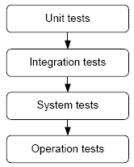
Waterfall Process Model
Analysis and Definition
Design
Implementation
Test
Usage and Maintenance
16

Slide 17
Disadvantage of the waterfall
The main drawback of the waterfall model is the difficulty of accommodating/easy change after the process is underway. One phase has to be complete before moving onto the next phase.

Slide 18
Disadvantage of the waterfall
Inflexible partitioning of the project into distinct stages makes it difficult to respond to changing customer requirements.
Therefore, this model is only appropriate when the requirements are well-understood and changes will be fairly limited during the design process.

Slide 19
Disadvantage of the waterfall
Just a few business systems have stable requirements.
The waterfall model is mostly used for large systems engineering projects where a system is developed at several sites.

Slide 20
The V-Model Process
Notes:
- Tinh thần chủ đạo của V-model là các hoạt động kiểm thử phải được tiến hành song song (theo khả năng có thể) ngay từ đầu chu trình cùng với các hoạt động phát triển.
- Trong mô hình Waterfall, kiểm thử được thực hiện trong một giai đoạn riêng biệt. Còn với mô hình chữ V, toàn bộ qui trình được chia thành hai nhóm giai đoạn tương ứng nhau: phát triển và kiểm thử.

Slide 21
Reuse-oriented development
Ex: Integrating web services from a range of suppliers

Slide 22
Evolutionary development
Exploratory development
Objective is to work with customers and to evolve a final system from an initial outline specification. Should start with well-understood requirements and add new features as proposed by the customer.
Throw-away prototyping
Objective is to understand the system requirements. Should start with poorly understood requirements to clarify what is really needed.

Slide 23
Evolutionary development

Slide 24
Evolutionary development
Disadvantages
Systems are often poorly structured;
Special skills (e.g. in languages for rapid prototyping) may be required.
Applicability
For small or medium-size interactive systems;
For parts of large systems (e.g. the user interface);
For short-lifetime systems.

Slide 25
Component-based software engineering
Based on systematic reuse where systems are integrated from existing components or COTS (Commercial-off-the-shelf) systems.
Processing stages
Component analysis;
Requirements modification;
System design with reuse;
Development and integration.
This approach is becoming increasingly used as component standards have emerged.

Slide 26
Process iteration
System requirements ALWAYS evolve in the course of a project so process iteration where earlier stages are reworked is always part of the process for large systems.
Iteration can be applied to any of the generic process models.
Two (related) approaches
Incremental delivery;
Spiral development.

Slide 27
Incremental delivery
Rather than deliver the system as a single delivery, the development and delivery is broken down into increments with each increment delivering part of the required functionality.
User requirements are prioritised and the highest priority requirements are included in early increments.
Once the development of an increment is started, the requirements are frozen though requirements for later increments can continue to evolve.

Slide 28
Incremental development

Slide 29
Advantages of the Incremental development
Customer value can be delivered with each increment so system functionality is available earlier.
Early increments act as a prototype to help suggest requirements for later increments.
Lower risk of overall project failure.
The highest priority system services are delivered first and tend to receive the most testing.

Slide 30
Disadvantages of the Incremental development
Increments should be relatively small (<20,000 lines of code)
It’s hard to map the client’s requirements onto increments of the right size.

Slide 31
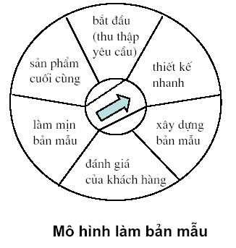
The Prototyping-Model Process
Listen to
Customer
Build/Revise
Mock-Up
Customer
Test-drives
Mock-up
[Pressman 97]

Slide 32
The Rapid Prototyping Model
Goal: explore requirements without building the complete product. To understand the system requirements and to clarify what is really needed
Start with part of the functionality that will (hopefully) yield significant insight
Build a prototype: focus on core functionality, not in efficiency
Use the prototype to refine the requirements
Repeat the process, expanding functionality

Slide 33
Rapid Prototyping + Waterfall
Update
Requirements
Write
Specification
Initial
Requirements
Choose
Functionality
Create
Software
Build
Prototype
Write
Test Plan

Slide 34
Spiral development
The spiral model is a risk-driven process model generator for software projects.
Process is represented as a spiral rather than as a sequence of activities with backtracking.
Each loop in the spiral represents a phase in the process.
No fixed phases such as specification or design - loops in the spiral are chosen depending on what is required.
Risks are explicitly assessed and resolved throughout the process.

Slide 35
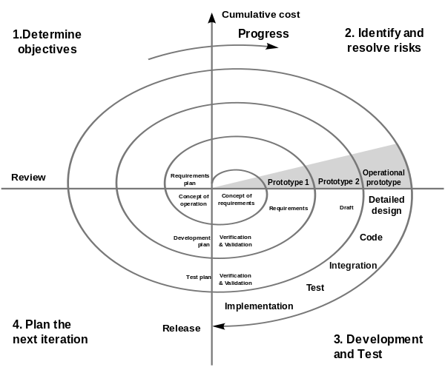
Spiral model of the software process

Slide 36
Spiral model sectors
Objective setting
Specific objectives for the phase are identified.
Risk assessment and reduction
Risks are assessed and activities put in place to reduce the key risks.
Development and validation
A development model for the system is chosen which can be any of the generic models.
Planning
The project is reviewed and the next phase of the spiral is planned.

Slide 37
Extreme programming
A variant of this incremental approach. An approach to development based on the development and delivery of very small increments of functionality.
Relies on constant code improvement, user involvement in the development team and pair programming.
Covered in Chapter Agile development method

Slide 38
Process activities
Software specification
Software design and implementation
Software validation
Software evolution

Slide 39
Software specification
The process of establishing what services are required and the constraints on the system’s operation and development.
Requirements engineering process
Feasibility study;
Requirements analysis & elicitation;
Requirements specification;
Requirements validation.

Slide 40
The requirements engineering process

Slide 41
Software design and implementation
The process of converting the system specification into an executable system.
Software design
Design a software structure that realises the specification;
Implementation
Translate this structure into an executable program;
The activities of design and implementation are closely related and may be inter-leaved.

Slide 42
Design process activities
General model of the design process and real, practical processes may adapt it in different ways.
Architectural design: the sub-systems building up the system and their relationships.
Abstract specification: it can be skipped, it is an essential part of critical systems design
Interface design: for each sub-system, its interface with other sub-systems is designed and documented.

Slide 43
Design process activities
Component design: services are allocated to components and the interfaces of these components are designed.
Data structure design
Algorithm design

Slide 44
The software design process

Slide 45
Structured methods
Systematic approaches to developing a software design.
The design is usually documented as a set of graphical models.
Possible models
Object model;
Sequence model;
State transition model;
Structural model;
Data-flow model.

Slide 46
Programming and debugging
Translating a design into a program and removing errors from that program.
Programming is a personal activity - there is no generic programming process.
Programmers carry out some program testing to discover faults in the program and remove these faults in the debugging process.

Slide 47
The debugging process

Slide 48
Software validation
Verification and validation (V & V) is intended to show that a system conforms to its specification and meets the requirements of the system customer.
Involves checking and review processes and system testing.
System testing involves executing the system with test cases that are derived from the specification of the real data to be processed by the system.

Slide 49
The testing process

Slide 50
Testing stages
Component or unit testing
Individual components are tested independently;
Components may be functions or objects or coherent groupings of these entities.
System testing
Testing of the system as a whole. Testing of emergent properties is particularly important.
Acceptance testing
Testing with customer data to check that the system meets the customer’s needs.

Slide 51
Testing phases

Slide 52
Software evolution
Software is inherently flexible and can change.
As requirements change through changing business circumstances, the software that supports the business must also evolve and change.
Although there has been a demarcation between development and evolution (maintenance) this is increasingly irrelevant as fewer and fewer systems are completely new.

Slide 53
System evolution

Slide 54
Key points
Software processes are the activities involved in producing and evolving a software system.
Software process models are abstract representations of these processes.
General activities are specification, design and implementation, validation and evolution.

Slide 55
Key points
Generic process models describe the organisation of software processes. Examples include the waterfall model, evolutionary development and component-based software engineering.
Iterative process models describe the software process as a cycle of activities.

Slide 56
Key points
Requirements engineering is the process of developing a software specification.
Design and implementation processes transform the specification to an executable program.
Validation involves checking that the system meets to its specification and user needs.
Evolution is concerned with modifying the system after it is in use.

Slide 57


